Slide 1
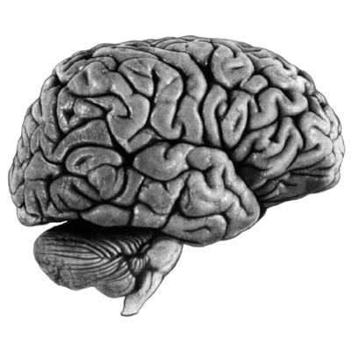
Welcome To The Odditory System!
AIR
amplification
FLUID
K⁺
Harry I. Haircell: Official Cochlea Mascot

Slide 2
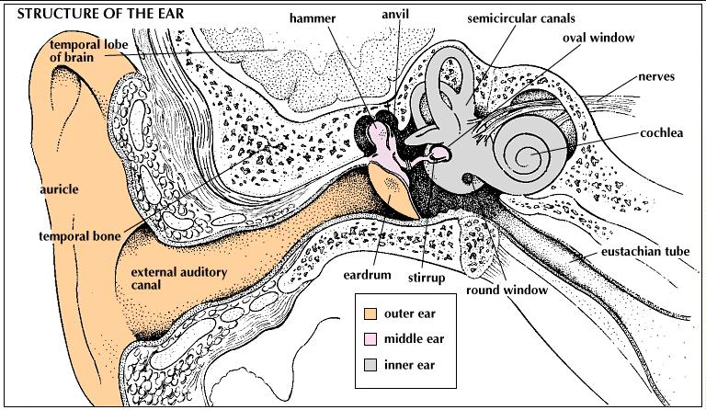
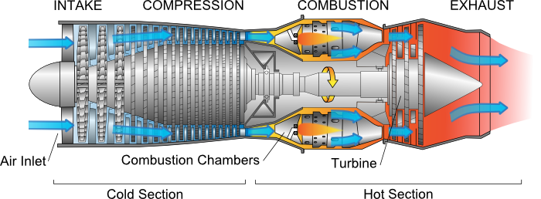
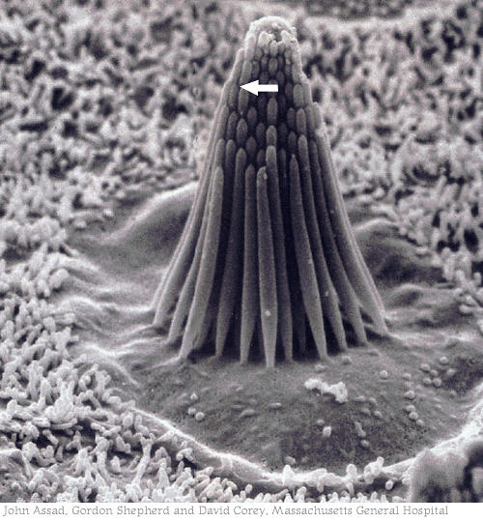
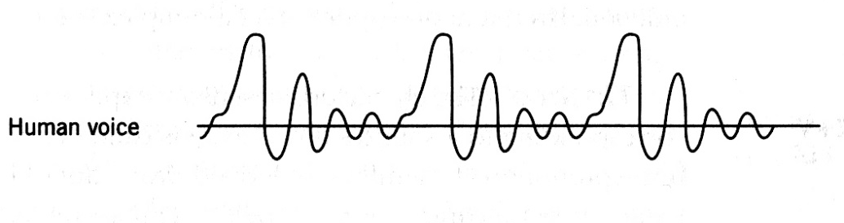
To hair cell
From sound wave

Slide 3
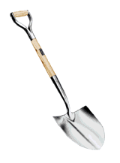
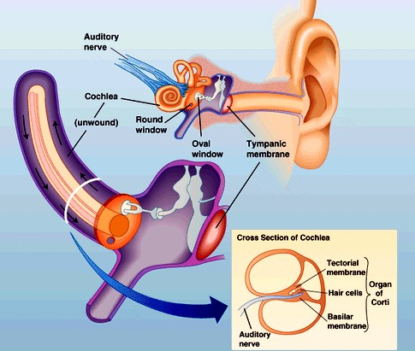
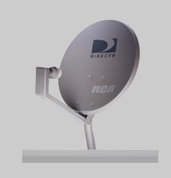
Two sources of ‘amplification’ in the Middle Ear
Levers:
Mechanical Advantage = Force x Distance
Parabolic Dishes:
Collect weak signal across large surface and concentrate onto a smaller surface

Slide 4
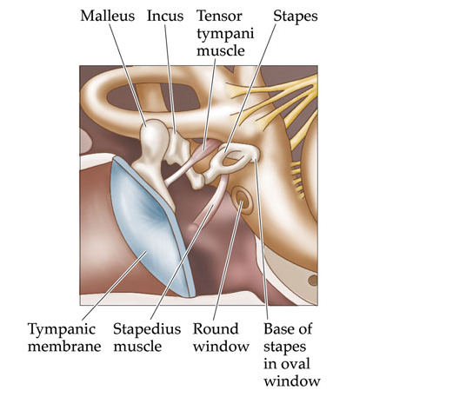
Two small muscles within the Middle Ear allow control over amplification.

Slide 5
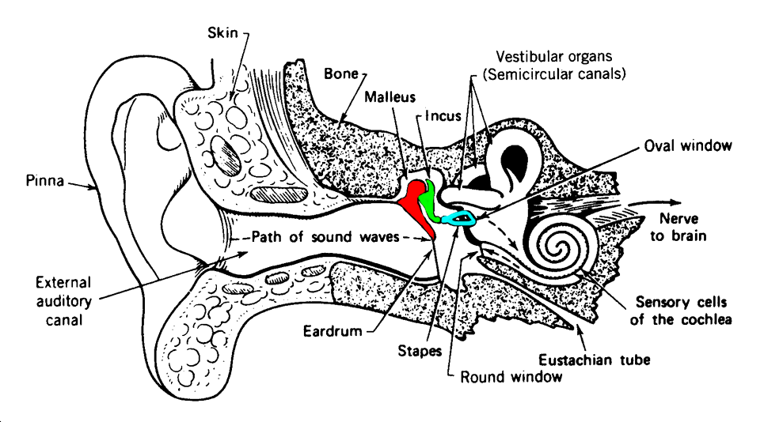

Ever Listened to Someone Talk Underwater?
You Are Right Now!
The Cochlea is Fluid-Filled

Slide 6
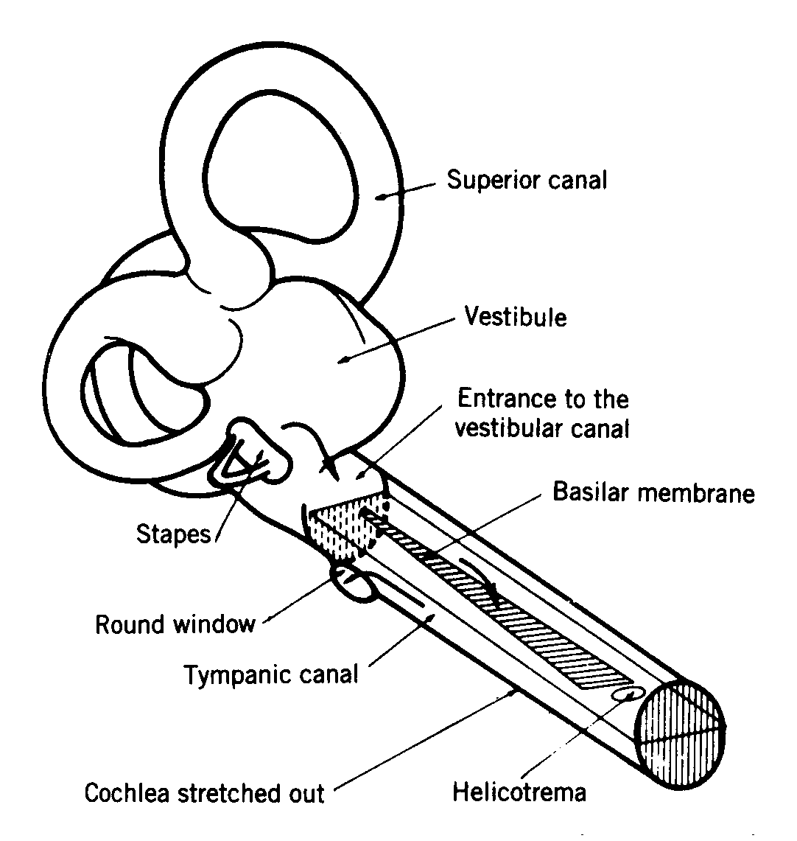

Slide 7
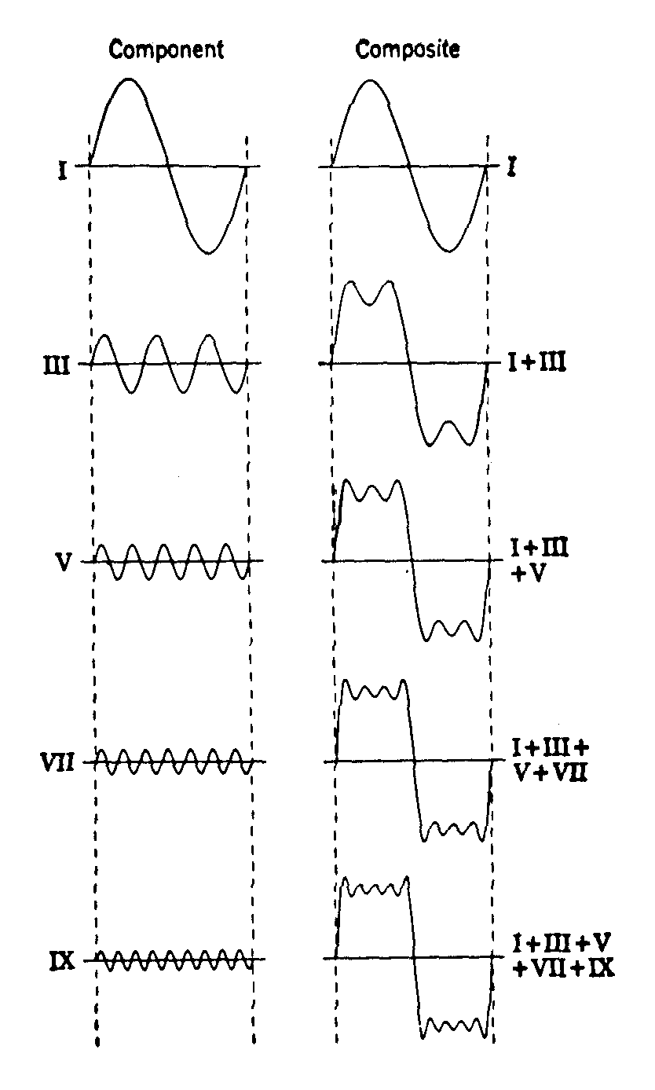
The Basilar Membrane performs a log-scaled Fourier Analysis on Complex (multi-frequency) Sounds.
Essentially, it acts as a ‘frequency filter’, pulling out high frequencies at the narrow end and low frequencies at the wide end.
3000 Hz
2500 Hz
2000 Hz
1500 Hz
500 Hz
Complex Sound
Inner hair cells.
Each tuned to a ‘best’ frequency.
Outer hair cells.
Provide ‘frequency specific’ amplification.

Slide 8
Frequency Spectrogram
Flute
4
3
kHz
2
1
0
Time

Slide 9
Frequency Spectrogram
4
Trumpet
3
kHz
2
1
0
Time

Slide 10

Frequency Spectrogram
Drum
4
3
kHz
2
1
0
Time

Slide 11
‘Place’ Theory of Frequency Encoding
Inner hair cells encode the frequencies of Complex Sounds via a log-scaled Fourier Analysis
  We’ll deal with Outer Hair Cells in a minute
Basilar Membrane dimensions are the key to understanding the ear’s version of Fourier Analysis
Narrow & Stiff to wide and flexible
High Freq at base, Low Freq at apex
33 mm

Slide 12
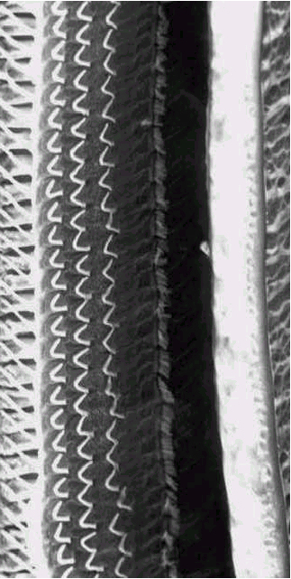
High Frequencies
A row of tiny, frequency-tuned microphones
Low Frequencies

Slide 13





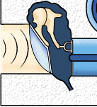
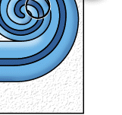
High Frequencies
Low Frequencies

Slide 14
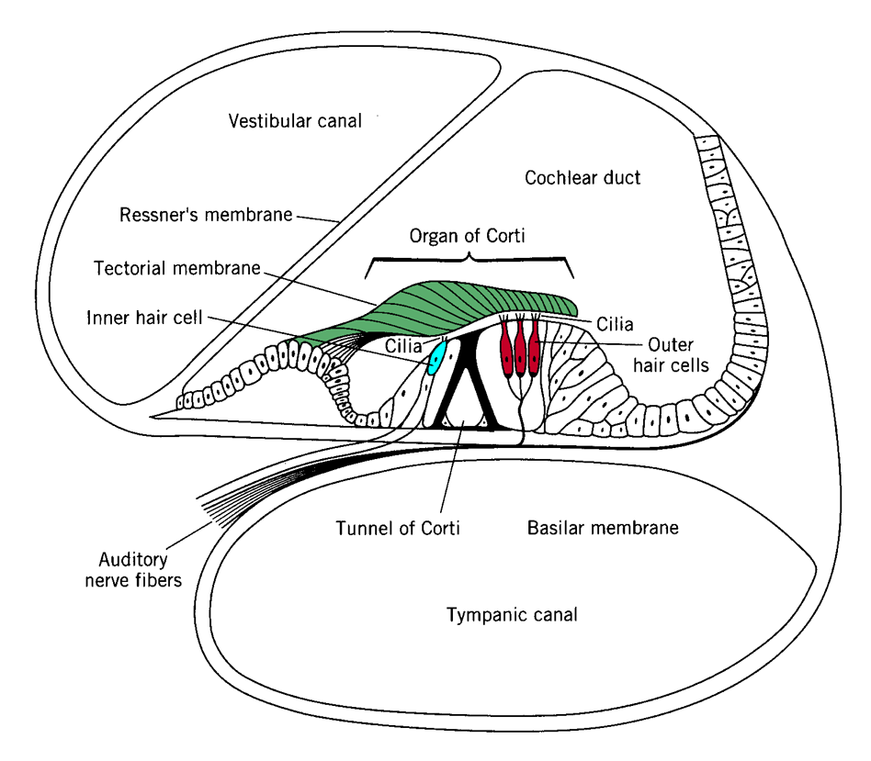
Cross-
Section View
Oval window
Round
window

Slide 15
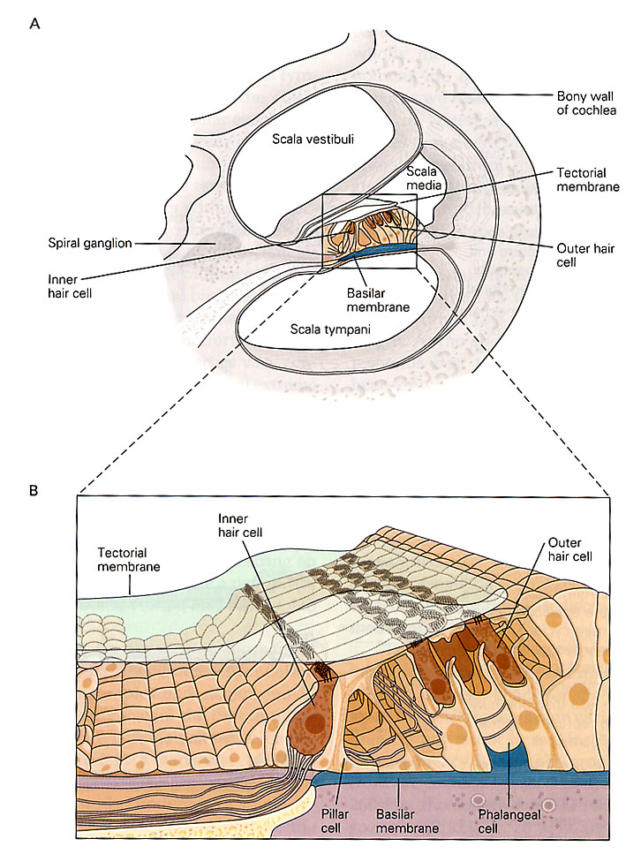
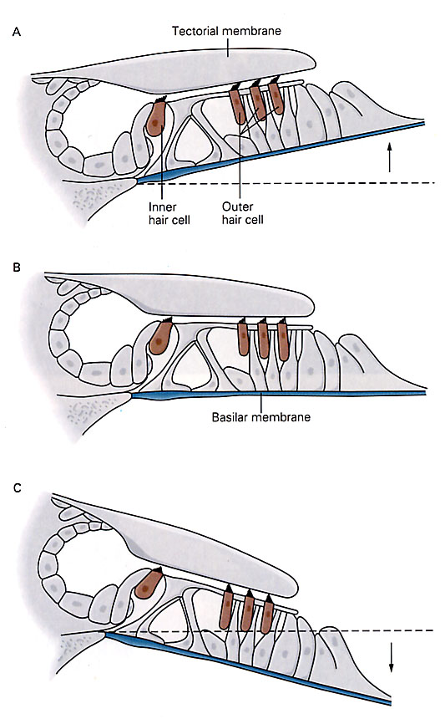

Slide 16
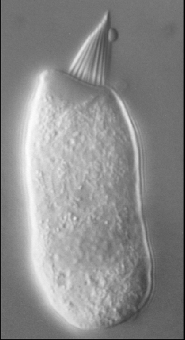
The World’s Smallest Microphone

Slide 17
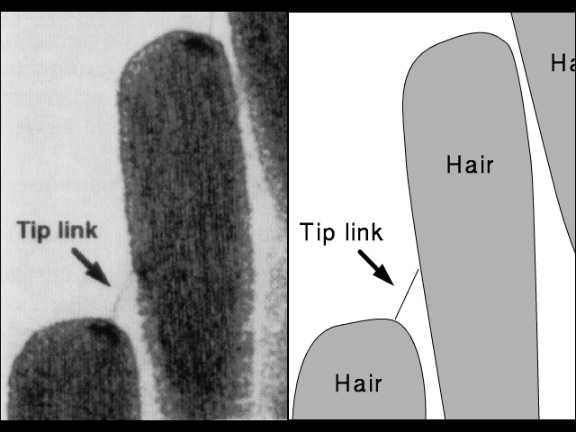
Tugging on tip links opens K⁺ channels

Slide 18
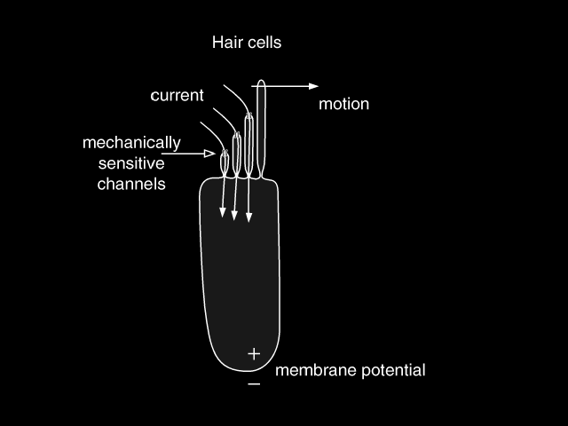
Inner hair cell near the base of the basilar membrane – tuned to high frequency sound

Slide 19
Inner hair cell near the apex of the basilar membrane – tuned to low frequency sound

Slide 20
Outer Hair Cells
and the Cochlear Amplifier
Cilia Attached to
Tectorial Membrane

Slide 21
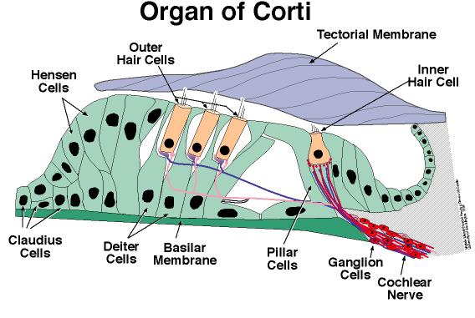
View from Above
Cross-
Section View
Outer Hair Cells act as ‘frequency specific’ amplifiers, like an ‘equalizer’ on your stereo

Slide 22
Outer Hair Cells
and the Cochlear Amplifier
Amplifier ‘off’
Amplifier ‘on’
K⁺
K⁺
In both cases, the AMPLITUDE of the sound is IDENTICAL. However, by activating outer hair cells and ‘pulling’ the tectorial membrane closer to the tips of inner hair cell cilia, the sound is heard as LOUDER on the right.

Slide 23
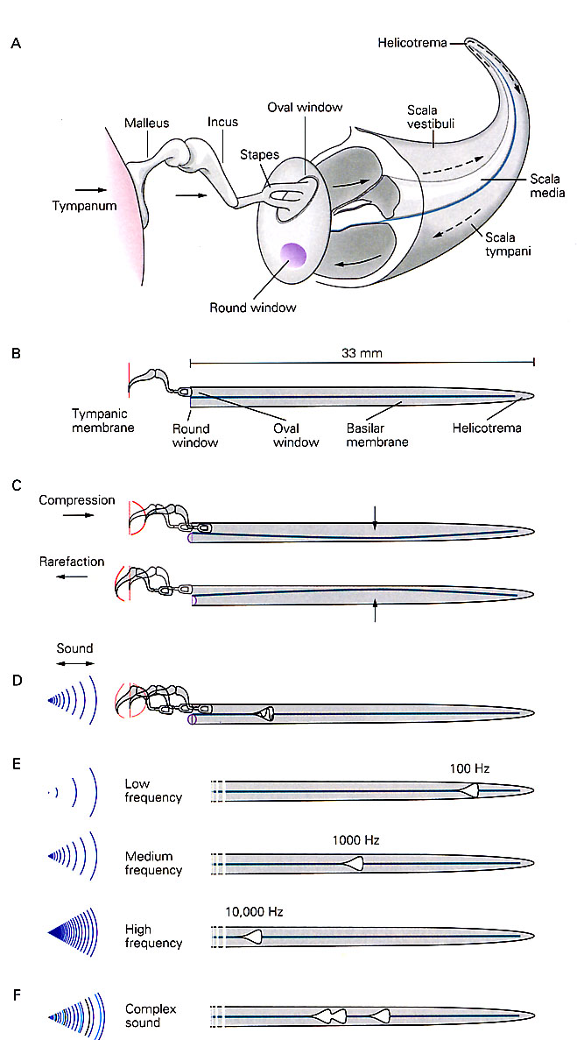
How does a ‘Cochlear
Implant’ work?

Slide 24
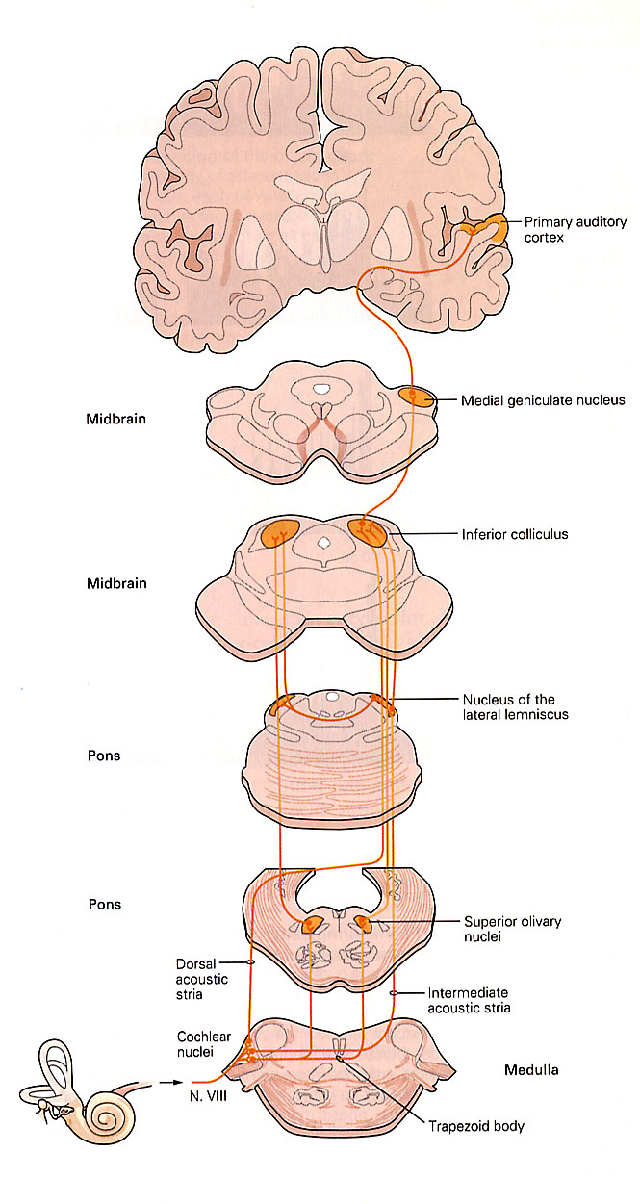
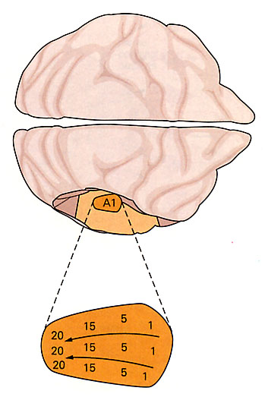

Slide 25
Right Temporal Cortex
Primary Auditory Cortex
1
2
3
4
5
6
TONOTOPIC
(it’s a map of the basilar membrane!)
Hi
Low
First we break it down . . .
Left Cochlea
(basilar membrane)

Slide 26
Complex Sound
‘Perceived’
Right Temporal Cortex
Secondary Auditory Cortex
1
2
3
4
5
6
Then we put it back together!
Note: this is a hypothetical model
1
2
3
4
5
6
Right Temporal Cortex
Primary Auditory Cortex
Hi
Low
TONOTOPIC
(it’s a map of the basilar membrane!)

Slide 28
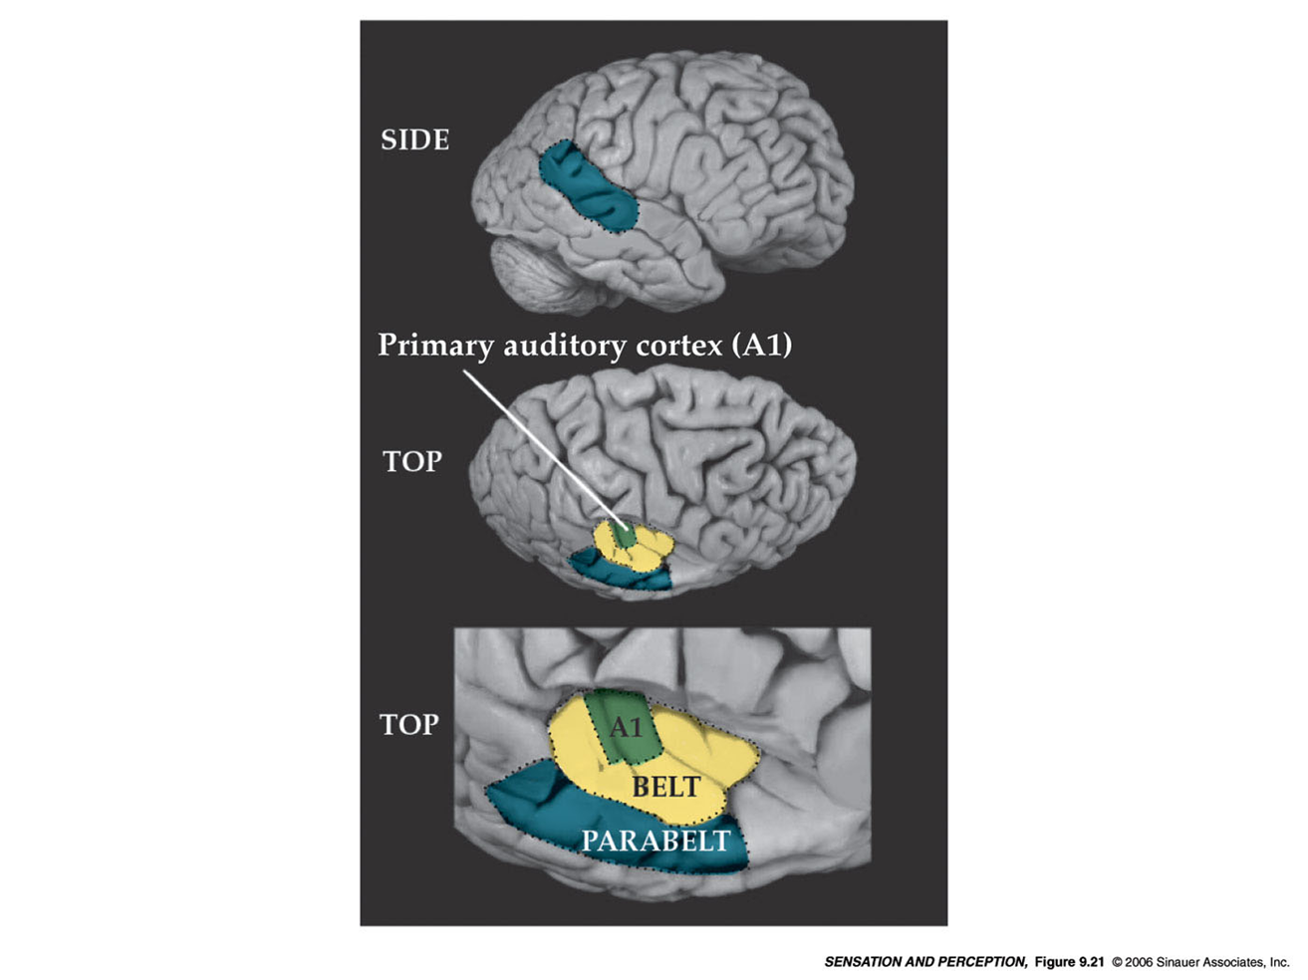

Slide 29
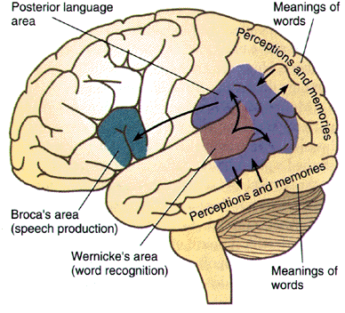

Slide 30
The McGurk Effect
‘Hearing’ with your eyes. . .
Generate ambiguous stimulus, with conflicting auditory and visual information
‘Who’ are you going to believe, your eyes or your ears?

Slide 31
Sound Localization
Doppler Shift (monaural)
Interaural intensity difference (Hi only)
Interaural time delay
Interaural phase difference

Slide 32
Primary
Motor Cortex
Telencephalon
WHAT?
Primary
Sensory Cortex
Thalamus
relay, feedback
Midbrain
WHERE?
Spinal Cord
reflexes, input, output
GENERAL Overview of Sensory System Organization
Rat
CNS
Motor output
Sensory input

Slide 33
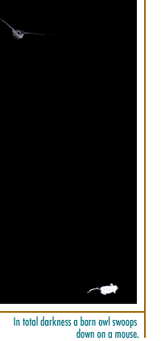
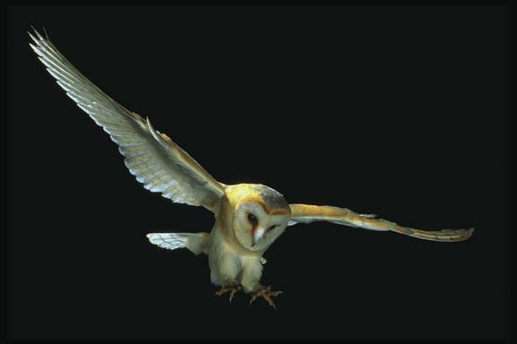

Slide 34
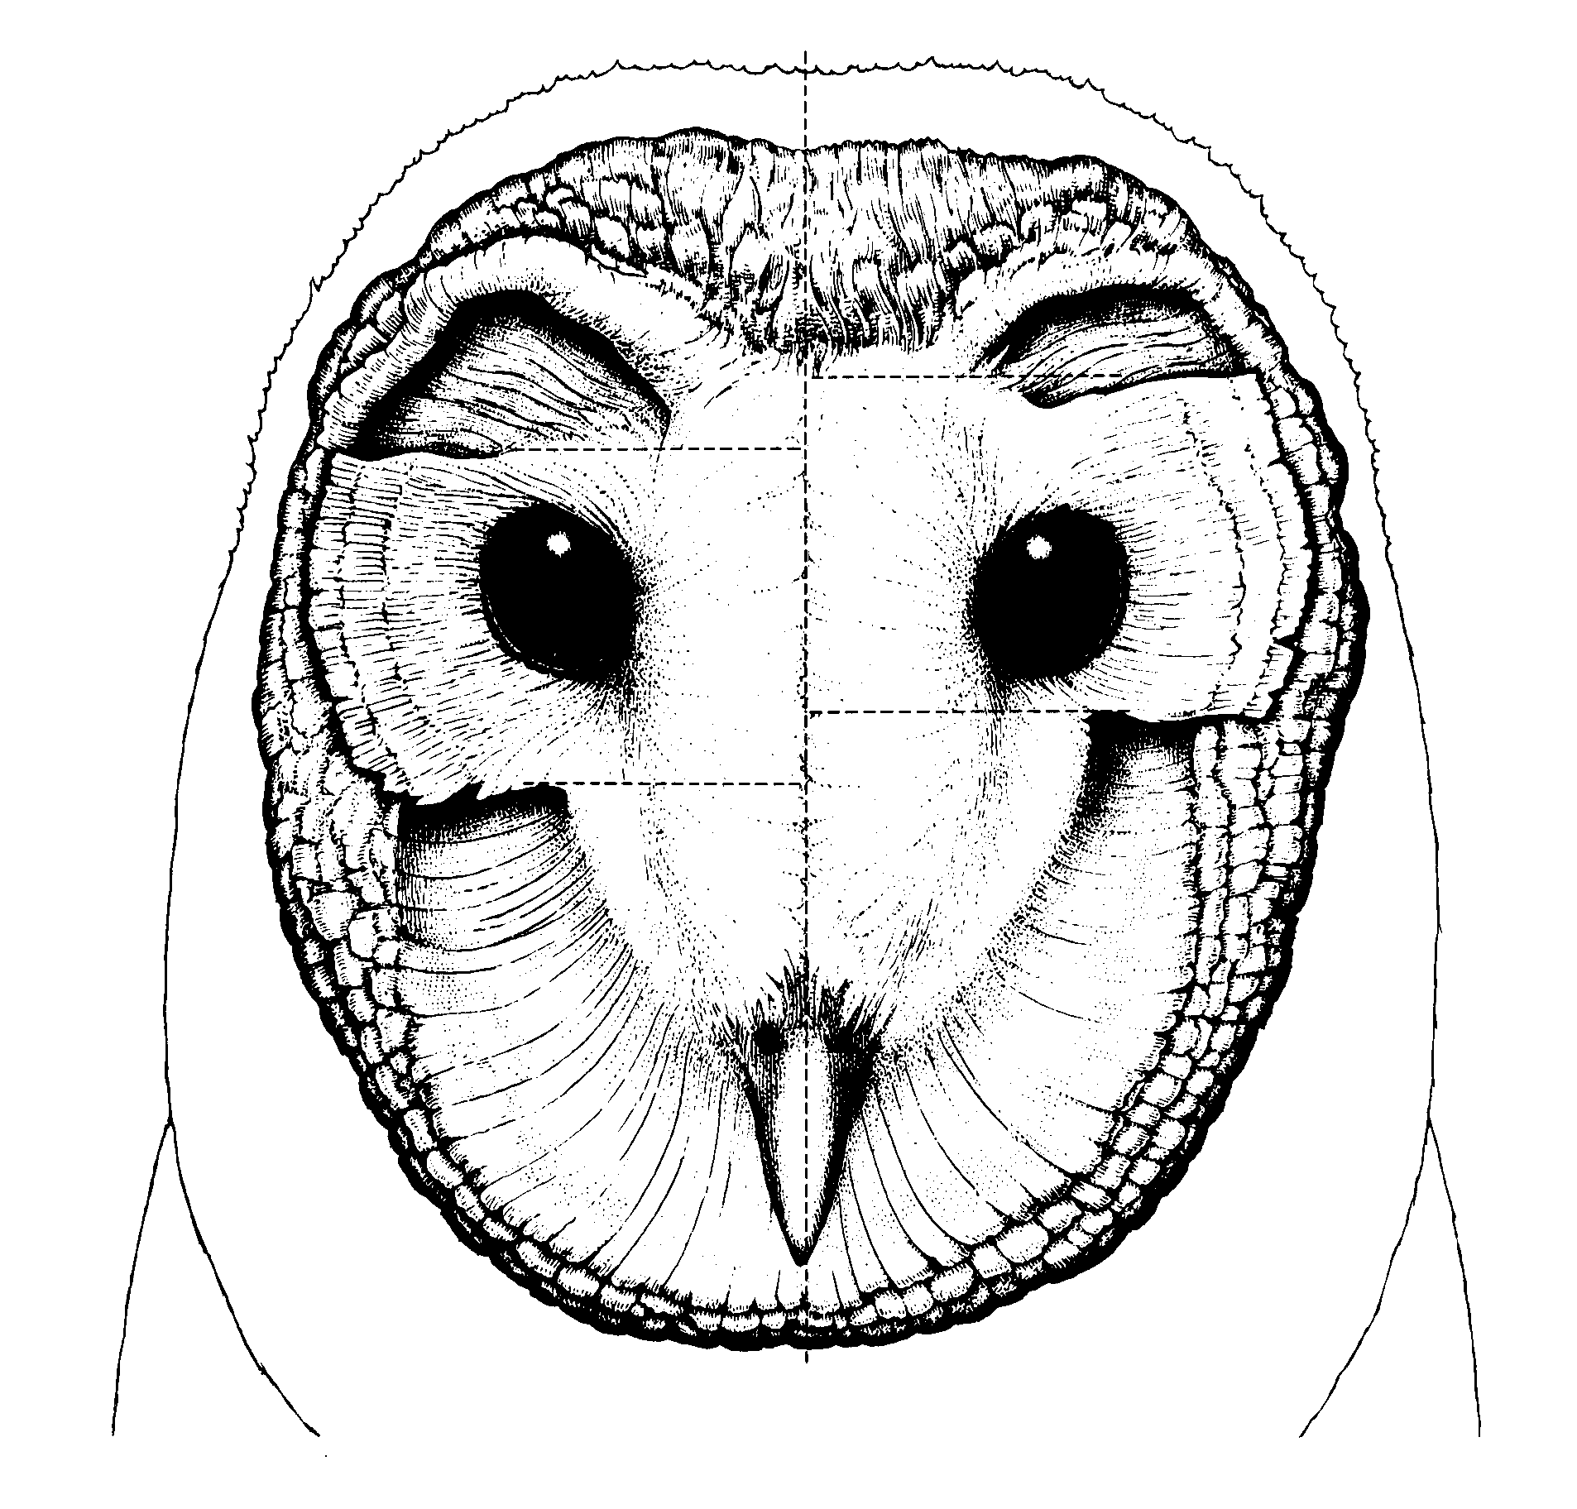
Barn Owl
crooked ears detect the ‘y’ axis

Slide 35
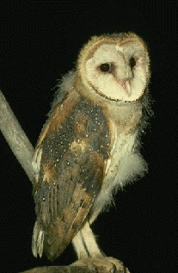
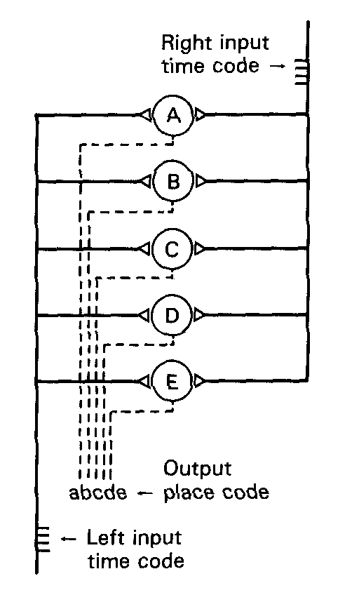
The speed of the neural impulse is a constant value
A
B
C
D
E
Summation of inputs is key

Slide 36
Sound Source
in Front
L R
A
B
C
D
E
Summation of inputs is key

Slide 37
Sound Source
on
Right side
L R
A
B
C
D
E
Summation of inputs is key

